Slide 1
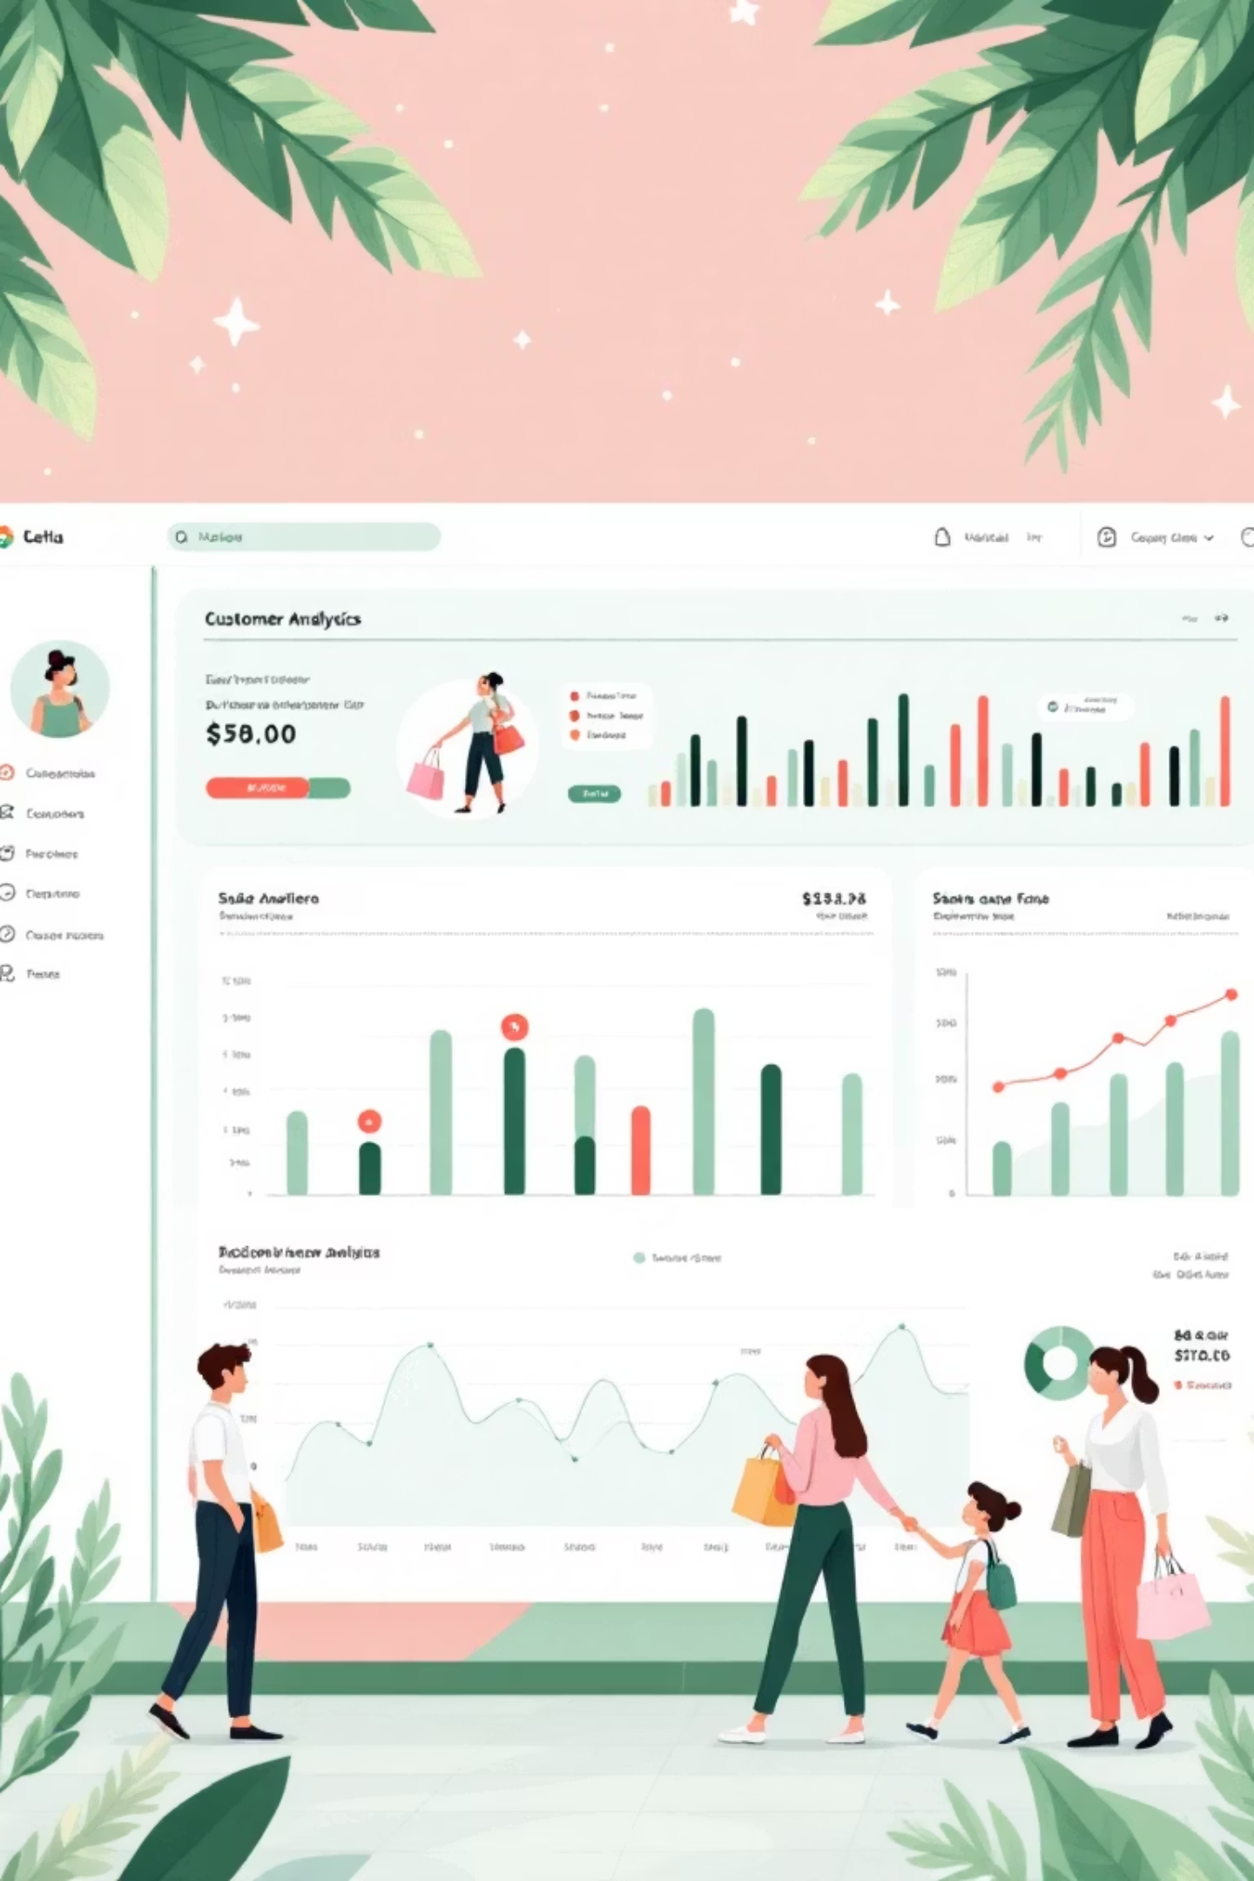
End-to-End Customer Shopping Behavior Analysis
A comprehensive data analytics workflow from raw data to actionable insights.

Slide 2

Project Overview: From Data to Decisions
This project showcases an end-to-end data analytics workflow, transforming raw customer data into valuable business insights.
Data Cleaning
Data Analysis
Visualization
Clean and prepare raw customer data using Python.
Store and analyze data using SQL to answer business questions.
Visualize insights with an interactive Power BI dashboard.
This workflow mirrors real industry practices, providing a holistic view of customer behavior.

Slide 3
Dataset Description: A Glimpse into Customer Habits
The dataset provides detailed customer-level shopping information for approximately 3,900 customers.
Demographics
Purchase Behavior
Product Information
Age, gender, and age group.
Purchase amount and previous purchases.
Item purchased and category.
Marketing Factors
Logistics & Feedback
Discount applied and subscription status.
Shipping type and review rating.

Slide 4

Data Cleaning & Preparation with Python
Python was instrumental in cleaning, standardizing, and preparing the raw dataset for robust SQL analysis.
Key Steps
Sample Code Snippet
Loaded dataset using Pandas.
import pandas as pd
df = pd.read_csv("customer_shopping_behavior.csv")
df['discount_applied'] = df['discount_applied'].str.title()
df['subscription_status'] = df['subscription_status'].str.title()
df.to_csv("customer_cleaned.csv", index=False)
Checked for missing values and duplicates.
Standardized categorical fields (e.g., Yes/No).
Ensured correct data types for numeric columns.
Created derived fields like age groups.
Exported cleaned data for SQL.

Slide 5





SQL Analysis: Uncovering Business Insights
The cleaned dataset was loaded into a PostgreSQL database, enabling in-depth analysis to answer critical business questions.
Data Storage
Cleaned data loaded into PostgreSQL.
Aggregations
Performed data aggregations.
Segmentation
Segmented customers for targeted analysis.
Revenue Patterns
Analyzed revenue and behavior patterns.

Slide 6
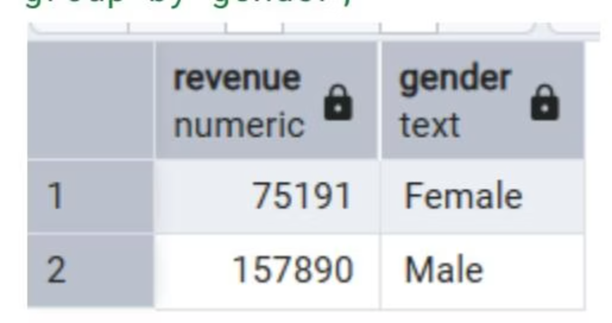
Key SQL Insights: Revenue & Customer Behavior
Q1: Total Revenue by Gender
Q2: Discount Users with High Spend
Male customers contribute more to total revenue.
Customers using discounts but spending above average show strong purchasing power.
1
64
2
73
3
90
4
85
5
97
These insights highlight distinct spending patterns and customer segments.

Slide 7
Key SQL Insights: Product Performance & Segmentation
Q3: Top 5 Products by Average Review Rating
Q7: Customer Segmentation by Previous Purchases
Gloves, Sandals, and Boots lead in customer satisfaction, indicating consistent quality.
Loyal customers form the largest segment, demonstrating strong retention.
Gloves
3.86
Loyal
3116
Sandals
3.84
Returning
701
Boots
3.82
New
83
Hat
3.80
Skirt
3.78

Slide 8
Key SQL Insights: Shipping, Subscriptions & Age Groups
Q4: Average Purchase by Shipping Type
Q5: Spending: Subscribers vs. Non-Subscribers
Express shipping users show higher spending behavior.
Non-subscribed customers generate higher average and total revenue.
Express
60.48
No
59.87
170436
Standard
58.46
Yes
59.49
62645
Q10: Revenue by Age Group
Q9: Repeat Buyers & Subscriptions
Young adults drive the highest revenue.
Repeat buyers are often non-subscribed.

Slide 9
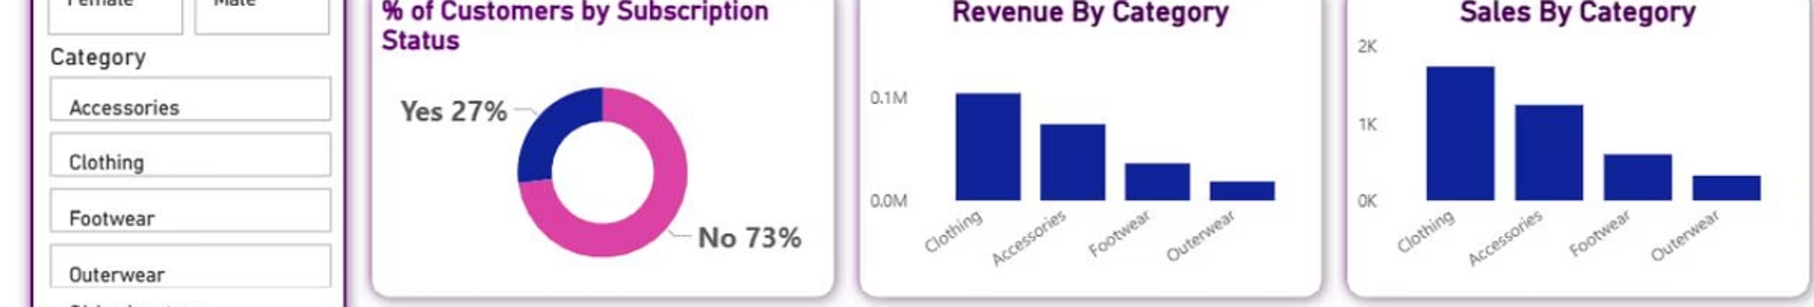
Power BI Dashboard: Interactive Visualizations
An interactive Power BI dashboard was developed to visualize key insights, allowing for dynamic filtering and clear storytelling.
Total Customers
Avg. Purchase Amount
Avg. Review Rating
Unique customer count.
Average spend per transaction.
Overall customer satisfaction.
The dashboard includes visualizations for revenue by category, sales by age group, and subscription status distribution, with interactive filters for gender, category, and shipping type.

Slide 10



Conclusion: A Full Data Analytics Lifecycle
This project successfully demonstrates a complete data analytics lifecycle, from raw data to actionable business intelligence.
SQL
Business Analysis
Python
Data Cleaning
Power BI
Insight Visualization
The findings provide critical insights into customer behavior, highlighting the importance of non-subscribed loyal customers and the revenue potential of young adult segments.

